Slide 1
Artificial Intelligence (AI)
Topic 3: A Knowledge Based Agent: Predicate Logic [FOL] (Wumpus Problem & Other Examples) & Inference in FOL

Slide 2
Agenda
What is FOL
Syntax and semantics of FOL
Using FOL
Wumpus world in FOL
Knowledge engineering in FOL
Learning Outcomes : Intelligent Agents
Methodology and Assessment Criteria for the Subject

Slide 3
Pros and cons of propositional logic
☺ Propositional logic is declarative
☺ Propositional logic allows partial/disjunctive/negated information
(unlike most data structures and databases)
Propositional logic is compositional:
meaning of B_{1,1} ∧ P_{1,2} is derived from meaning of B_{1,1} and of P_{1,2}
☺ Meaning in propositional logic is context-independent
(unlike natural language, where meaning depends on context)
☹ Propositional logic has very limited expressive power
(unlike natural language)
E.g., cannot say "pits cause breezes in adjacent squares“
except by writing one sentence for each square

Slide 4
First-order logic
Whereas propositional logic assumes the world contains facts,
first-order logic (like natural language) assumes the world contains
Objects: people, houses, numbers, colors, baseball games, wars, …
Relations: red, round, prime, brother of, bigger than, part of, comes between, …
Functions: father of, best friend, one more than, plus, …

Slide 5
Syntax of FOL: Basic elements
Constants King John, 2, NUS,...
Predicates Brother, >,...
Functions Sqrt, LeftLegOf,...
Variables x, y, a, b,...
Connectives ¬, ⇒, ∧, ∨, ⇔
Equality =
Quantifiers ∀, ∃

Slide 6
Atomic sentences
Atomic sentence = predicate (term₁,...,term_{n}) or term₁ = term₂
Term = function (term₁,...,term_{n}) or constant or variable
E.g., Brother(KingJohn,RichardTheLionheart) > (Length(LeftLegOf(Richard)), Length(LeftLegOf(KingJohn)))

Slide 7
Complex sentences
Complex sentences are made from atomic sentences using connectives
¬S, S₁ ∧ S₂, S₁ ∨ S₂, S₁ ⇒ S₂, S₁ ⇔ S₂,
E.g. Sibling(KingJohn,Richard) ⇒ Sibling(Richard,KingJohn)
>(1,2) ∨ ≤ (1,2)
>(1,2) ∧ ¬ >(1,2)

Slide 8
Truth in first-order logic
Sentences are true with respect to a model and an interpretation
Model contains objects (domain elements) and relations among them
Interpretation specifies referents for
constant symbols → objects
predicate symbols → relations
function symbols → functional relations
An atomic sentence predicate(term₁,...,term_{n}) is true
iff the objects referred to by term₁,...,term_{n}
are in the relation referred to by predicate

Slide 9
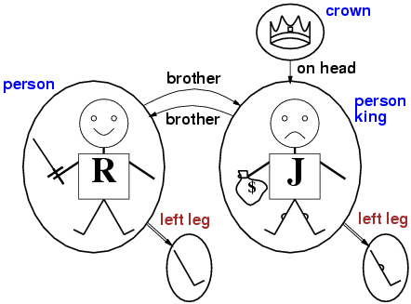
Models for FOL: Example

Slide 10
Universal quantification
∀<variables> <sentence>
Everyone at NUS is smart:
∀x At(x,NUS) ⇒ Smart(x)
∀x P is true in a model m iff P is true with x being each possible object in the model
Roughly speaking, equivalent to the conjunction of instantiations of P
At(KingJohn,NUS) ⇒ Smart(KingJohn)
∧ At(Richard,NUS) ⇒ Smart(Richard)
∧ At(NUS,NUS) ⇒ Smart(NUS)
∧ ...

Slide 11
A common mistake to avoid
Typically, ⇒ is the main connective with ∀
Common mistake: using ∧ as the main connective with ∀:
∀x At(x,NUS) ∧ Smart(x)
means “Everyone is at NUS and everyone is smart”

Slide 12
Existential quantification
∃<variables> <sentence>
Someone at NUS is smart:
∃x At(x,NUS) ∧ Smart(x)$
∃x P is true in a model m iff P is true with x being some possible object in the model
Roughly speaking, equivalent to the disjunction of instantiations of P
At(KingJohn,NUS) ∧ Smart(KingJohn)
∨ At(Richard,NUS) ∧ Smart(Richard)
∨ At(NUS,NUS) ∧ Smart(NUS)
∨ ...

Slide 13
Another common mistake to avoid
Typically, ∧ is the main connective with ∃
Common mistake: using ⇒ as the main connective with ∃:
∃x At(x,NUS) ⇒ Smart(x)
is true if there is anyone who is not at NUS!

Slide 14
Properties of quantifiers
∀x ∀y is the same as ∀y ∀x
∃x ∃y is the same as ∃y ∃x
∃x ∀y is not the same as ∀y ∃x
∃x ∀y Loves(x,y)
“There is a person who loves everyone in the world”
∀y ∃x Loves(x,y)
“Everyone in the world is loved by at least one person”
Quantifier duality: each can be expressed using the other
∀x Likes(x,IceCream) ¬∃x ¬Likes(x,IceCream)
∃x Likes(x,Broccoli) ¬∀x ¬Likes(x,Broccoli)

Slide 15
Equality
term₁ = term₂ is true under a given interpretation if and only if term₁ and term₂ refer to the same object
E.g., definition of Sibling in terms of Parent:
∀x,y Sibling(x,y) ⇔ [¬(x = y) ∧ ∃m,f ¬ (m = f) ∧ Parent(m,x) ∧ Parent(f,x) ∧ Parent(m,y) ∧ Parent(f,y)]

Slide 16
Using FOL
The kinship domain:
Brothers are siblings
∀x,y Brother(x,y) ⇔ Sibling(x,y)
One's mother is one's female parent
∀m,c Mother(c) = m ⇔ (Female(m) ∧ Parent(m,c))
“Sibling” is symmetric
∀x,y Sibling(x,y) ⇔ Sibling(y,x)

Slide 17
Using FOL
The set domain:
∀s Set(s) ⇔ (s = {} ) ∨ (∃x,s₂ Set(s₂) ∧ s = {x|s₂})
¬∃x,s {x|s} = {}
∀x,s x ∈ s ⇔ s = {x|s}
∀x,s x ∈ s ⇔ [ ∃y,s₂} (s = {y|s₂} ∧ (x = y ∨ x ∈ s₂))]
∀s₁,s₂ s₁ ⊆ s₂ ⇔ (∀x x ∈ s₁ ⇒ x ∈ s₂)
∀s₁,s₂ (s₁ = s₂) ⇔ (s₁ ⊆ s₂ ∧ s₂ ⊆ s₁)
∀x,s₁,s₂ x ∈ (s₁ ∩ s₂) ⇔ (x ∈ s₁ ∧ x ∈ s₂)
∀x,s₁,s₂ x ∈ (s₁ ∪ s₂) ⇔ (x ∈ s₁ ∨ x ∈ s₂)

Slide 18
Interacting with FOL KBs
Suppose a wumpus-world agent is using an FOL KB and perceives a smell and a breeze (but no glitter) at t=5:
Tell(KB,Percept([Smell,Breeze,None],5))
Ask(KB,∃a BestAction(a,5)) I.e., does the KB entail some best action at t=5?
Answer: Yes, {a/Shoot} ← substitution (binding list)
Given a sentence S and a substitution σ,
Sσ denotes the result of plugging σ into S; e.g.,
S = Smarter(x,y)
σ = {x/Hillary,y/Bill}
Sσ = Smarter(Hillary,Bill)
Ask(KB,S) returns some/all σ such that KB╞ σ

Slide 19
Knowledge base for the wumpus world
Perception
∀t,s,b Percept([s,b,Glitter],t) ⇒ Glitter(t)
Reflex
∀t Glitter(t) ⇒ BestAction(Grab,t)

Slide 20
Deducing hidden properties
∀x,y,a,b Adjacent([x,y],[a,b]) ⇔
[a,b] ∈ {[x+1,y], [x-1,y],[x,y+1],[x,y-1]}
Properties of squares:
∀s,t At(Agent,s,t) ∧ Breeze(t) ⇒ Breezy(s)
Squares are breezy near a pit:
Diagnostic rule---infer cause from effect
∀s Breezy(s) ⇒ \Exi{r} Adjacent(r,s) ∧ Pit(r)$
Causal rule---infer effect from cause
∀r Pit(r) ⇒ [∀s Adjacent(r,s) ⇒ Breezy(s)$ ]

Slide 21
Knowledge engineering in FOL
Identify the task
Assemble the relevant knowledge
Decide on a vocabulary of predicates, functions, and constants
Encode general knowledge about the domain
Encode a description of the specific problem instance
Pose queries to the inference procedure and get answers
Debug the knowledge base

Slide 22
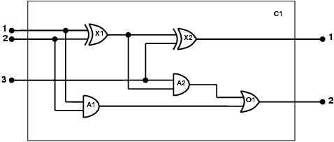
The electronic circuits domain
One-bit full adder

Slide 23
The electronic circuits domain
Identify the task
Does the circuit actually add properly? (circuit verification)
Assemble the relevant knowledge
Composed of wires and gates; Types of gates (AND, OR, XOR, NOT)
Irrelevant: size, shape, color, cost of gates
Decide on a vocabulary
Alternatives:
Type(X₁) = XOR
Type(X₁, XOR)
XOR(X₁)

Slide 24
The electronic circuits domain
Encode general knowledge of the domain
∀t₁,t₂ Connected(t₁, t₂) ⇒ Signal(t₁) = Signal(t₂)
∀t Signal(t) = 1 ∨ Signal(t) = 0
1 ≠ 0
∀t₁,t₂ Connected(t₁, t₂) ⇒ Connected(t₂, t₁)
∀g Type(g) = OR ⇒ Signal(Out(1,g)) = 1 ⇔ ∃n Signal(In(n,g)) = 1
∀g Type(g) = AND ⇒ Signal(Out(1,g)) = 0 ⇔ ∃n Signal(In(n,g)) = 0
∀g Type(g) = XOR ⇒ Signal(Out(1,g)) = 1 ⇔ Signal(In(1,g)) ≠ Signal(In(2,g))
∀g Type(g) = NOT ⇒ Signal(Out(1,g)) ≠ Signal(In(1,g))

Slide 25
The electronic circuits domain
6.Encode the specific problem instance
Type(X₁) = XOR Type(X₂) = XOR
Type(A₁) = AND Type(A₂) = AND
Type(O₁) = OR
Connected(Out(1,X₁),In(1,X₂)) Connected(In(1,C₁),In(1,X₁))
Connected(Out(1,X₁),In(2,A₂)) Connected(In(1,C₁),In(1,A₁))
Connected(Out(1,A₂),In(1,O₁)) Connected(In(2,C₁),In(2,X₁))
Connected(Out(1,A₁),In(2,O₁)) Connected(In(2,C₁),In(2,A₁))
Connected(Out(1,X₂),Out(1,C₁)) Connected(In(3,C₁),In(2,X₂))
Connected(Out(1,O₁),Out(2,C₁)) Connected(In(3,C₁),In(1,A₂))

Slide 26
The electronic circuits domain
7. Pose queries to the inference procedure
8.What are the possible sets of values of all the terminals for the adder circuit?
∃i₁,i₂,i₃,o₁,o₂ Signal(In(1,C_1)) = i₁ ∧ Signal(In(2,C₁)) = i₂ ∧ Signal(In(3,C₁)) = i₃ ∧ Signal(Out(1,C₁)) = o₁ ∧ Signal(Out(2,C₁)) = o₂
8. Debug the knowledge base 9. May have omitted assertions like 1 ≠ 0

Slide 27
Summary
First-order logic:
objects and relations are semantic primitives
syntax: constants, functions, predicates, equality, quantifiers
Increased expressive power: sufficient to define wumpus world

Slide 28
Inference in FOL
Reducing first-order inference to propositional inference
Unification
Generalized Modus Ponens
Forward chaining
Backward chaining
Resolution

Slide 29
Universal instantiation (UI)
Every instantiation of a universally quantified sentence is entailed by it:
∀v α Subst({v/g}, α)
for any variable v and ground term g
E.g., ∀x King(x) ∧ Greedy(x) ⇒ Evil(x) yields:
King(John) ∧ Greedy(John) ⇒ Evil(John)
King(Richard) ∧ Greedy(Richard) ⇒ Evil(Richard)
King(Father(John)) ∧ Greedy(Father(John)) ⇒ Evil(Father(John))
.
.
.

Slide 30
Existential instantiation (EI)
For any sentence α, variable v, and constant symbol k that does not appear elsewhere in the knowledge base:
∃v α
Subst({v/k}, α)
E.g., ∃x Crown(x) ∧ OnHead(x,John) yields:
Crown(C₁) ∧ OnHead(C₁,John)
provided C₁ is a new constant symbol, called a Skolem constant

Slide 31
Reduction to propositional inference
Suppose the KB contains just the following:
∀x King(x) ∧ Greedy(x) ⇒ Evil(x)
King(John)
Greedy(John)
Brother(Richard,John)
Instantiating the universal sentence in all possible ways, we have:
King(John) ∧ Greedy(John) ⇒ Evil(John)
King(Richard) ∧ Greedy(Richard) ⇒ Evil(Richard)
King(John)
Greedy(John)
Brother(Richard,John)
The new KB is propositionalized: proposition symbols are
King(John), Greedy(John), Evil(John), King(Richard), etc.

Slide 32
Reduction (2)
Every FOL KB can be propositionalized so as to preserve entailment
(A ground sentence is entailed by new KB iff entailed by original KB)
Idea: propositionalize KB and query, apply resolution, return result
Problem: with function symbols, there are infinitely many ground terms,
e.g., Father(Father(Father(John)))

Slide 33
Reduction (3)
Theorem: Herbrand (1930). If a sentence α is entailed by an FOL KB, it is entailed by a finite subset of the propositionalized KB
Idea: For n = 0 to ∞ do
create a propositional KB by instantiating with depth-$n$ terms
see if α is entailed by this KB
Problem: works if α is entailed, loops if α is not entailed
Theorem: Turing (1936), Church (1936) Entailment for FOL is semidecidable (algorithms exist that say yes to every entailed sentence, but no algorithm exists that also says no to every nonentailed sentence.)

Slide 34
Problems with propositionalization
Propositionalization seems to generate lots of irrelevant sentences.
E.g., from:
∀x King(x) ∧ Greedy(x) ⇒ Evil(x)
King(John)
∀y Greedy(y)
Brother(Richard,John)
it seems obvious that Evil(John), but propositionalization produces lots of facts such as Greedy(Richard) that are irrelevant
With p k-ary predicates and n constants, there are p·n^{k} instantiations.

Slide 35
Unification (1)
We can get the inference immediately if we can find a substitution θ such that King(x) and Greedy(x) match King(John) and Greedy(y)
θ = {x/John,y/John} works
Unify(α,β) = θ if αθ = βθ
p q θ
Knows(John,x) Knows(John,Jane)
Knows(John,x) Knows(y,OJ)
Knows(John,x) Knows(y,Mother(y))
Knows(John,x) Knows(x,OJ)
Standardizing apart eliminates overlap of variables, e.g., Knows(z₁₇,OJ)

Slide 36
Unification (2)
We can get the inference immediately if we can find a substitution θ such that King(x) and Greedy(x) match King(John) and Greedy(y)
θ = {x/John,y/John} works
Unify(α,β) = θ if αθ = βθ
p q θ
Knows(John,x) Knows(John,Jane) {x/Jane}}
Knows(John,x) Knows(y,OJ)
Knows(John,x) Knows(y,Mother(y))
Knows(John,x) Knows(x,OJ)
Standardizing apart eliminates overlap of variables, e.g., Knows(z₁₇,OJ)

Slide 37
Unification (3)
We can get the inference immediately if we can find a substitution θ such that King(x) and Greedy(x) match King(John) and Greedy(y)
θ = {x/John,y/John} works
Unify(α,β) = θ if αθ = βθ
p q θ
Knows(John,x) Knows(John,Jane) {x/Jane}}
Knows(John,x) Knows(y,OJ) {x/OJ,y/John}}
Knows(John,x) Knows(y,Mother(y))
Knows(John,x) Knows(x,OJ)
Standardizing apart eliminates overlap of variables, e.g., Knows(z₁₇,OJ)

Slide 38
Unification (4)
We can get the inference immediately if we can find a substitution θ such that King(x) and Greedy(x) match King(John) and Greedy(y)
θ = {x/John,y/John} works
Unify(α,β) = θ if αθ = βθ
p q θ
Knows(John,x) Knows(John,Jane) {x/Jane}}
Knows(John,x) Knows(y,OJ) {x/OJ,y/John}}
Knows(John,x) Knows(y,Mother(y)) {y/John,x/Mother(John)}}
Knows(John,x) Knows(x,OJ)
Standardizing apart eliminates overlap of variables, e.g., Knows(z₁₇,OJ)

Slide 39
Unification (5)
We can get the inference immediately if we can find a substitution θ such that King(x) and Greedy(x) match King(John) and Greedy(y)
θ = {x/John,y/John} works
Unify(α,β) = θ if αθ = βθ
p q θ
Knows(John,x) Knows(John,Jane) {x/Jane}}
Knows(John,x) Knows(y,OJ) {x/OJ,y/John}}
Knows(John,x) Knows(y,Mother(y)) {y/John,x/Mother(John)}}
Knows(John,x) Knows(x,OJ) {fail}
Standardizing apart eliminates overlap of variables, e.g., Knows(z₁₇,OJ)

Slide 40
Unification (6)
To unify Knows(John,x) and Knows(y,z),
θ = {y/John, x/z } or θ = {y/John, x/John, z/John}
The first unifier is more general than the second.
There is a single most general unifier (MGU) that is unique up to renaming of variables.
MGU = { y/John, x/z }

Slide 41
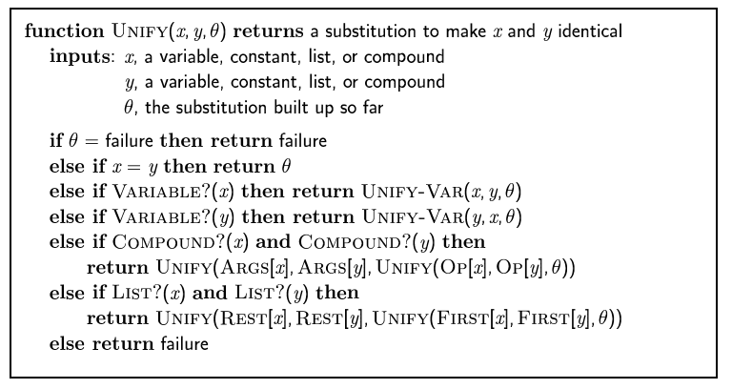
The unification algorithm

Slide 42
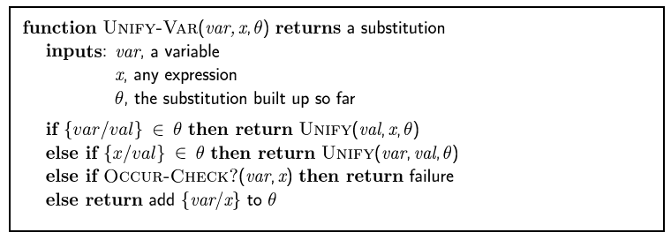
The unification algorithm

Slide 43
Generalized Modus Ponens (GMP)
where p_{i}'θ = p_{i} θ for all i
p₁', p₂', … , p_{n}', ( p₁ ∧ p₂ ∧ … ∧ p_{n} ⇒q)
qθ
p₁' is King(John) p₁ is King(x)
p₂' is Greedy(y) p₂ is Greedy(x)
θ is {x/John,y/John} q is Evil(x)
q θ is Evil(John)
GMP used with KB of definite clauses (exactly one positive literal)
All variables assumed universally quantified

Slide 44
Soundness of GMP
Need to show that
p₁', …, p_{n}', (p₁ ∧ … ∧ p_{n} ⇒ q) ╞ qθ
provided that p_{i}'θ = p_{i}θ for all I
Lemma: For any sentence p, we have p ╞ pθ by UI
(p₁ ∧ … ∧ p_{n} ⇒ q) ╞ (p₁ ∧ … ∧ p_{n} ⇒ q)θ = (p₁θ ∧ … ∧ p_{n}θ ⇒ qθ)
p₁', \; …, \;p_{n}' ╞ p₁' ∧ … ∧ p_{n}' ╞ p₁'θ ∧ … ∧ p_{n}'θ
From 1 and 2, qθ follows by ordinary Modus Ponens

Slide 45
Example knowledge base
The law says that it is a crime for an American to sell weapons to hostile nations. The country Nono, an enemy of America, has some missiles, and all of its missiles were sold to it by Colonel West, who is American.
Prove that Col. West is a criminal

Slide 46
Example knowledge base contd.
... it is a crime for an American to sell weapons to hostile nations:
American(x) ∧ Weapon(y) ∧ Sells(x,y,z) ∧ Hostile(z) ⇒ Criminal(x)
Nono … has some missiles, i.e., ∃x Owns(Nono,x) ∧ Missile(x):
Owns(Nono,M₁) and Missile(M₁)
… all of its missiles were sold to it by Colonel West
Missile(x) ∧ Owns(Nono,x) ⇒ Sells(West,x,Nono)
Missiles are weapons:
Missile(x) ⇒ Weapon(x)
An enemy of America counts as "hostile“:
Enemy(x,America) ⇒ Hostile(x)
West, who is American …
American(West)
The country Nono, an enemy of America …
Enemy(Nono,America)

Slide 47
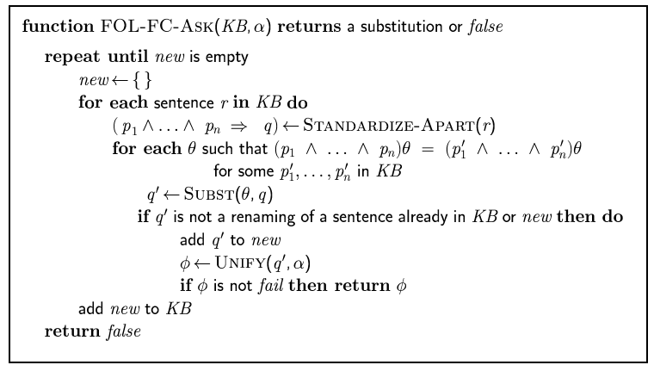
Forward chaining algorithm

Slide 48
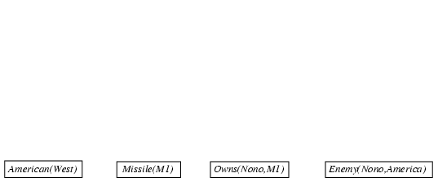
Forward chaining proof (1)

Slide 49
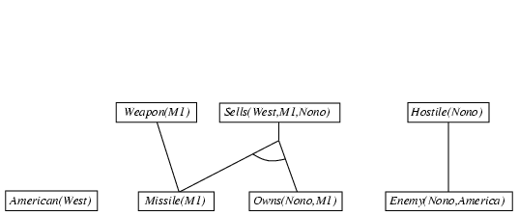
Forward chaining proof

Slide 50
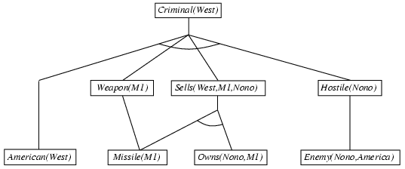
Forward chaining proof

Slide 51
Properties of forward chaining
Sound and complete for first-order definite clauses
Datalog = first-order definite clauses + no functions
FC terminates for Datalog in finite number of iterations
May not terminate in general if α is not entailed
This is unavoidable: entailment with definite clauses is semidecidable

Slide 52
Efficiency of forward chaining
Incremental forward chaining: no need to match a rule on iteration k if a premise wasn't added on iteration k-1
⇒ match each rule whose premise contains a newly added positive literal
Matching itself can be expensive:
Database indexing allows O(1) retrieval of known facts
e.g., query Missile(x) retrieves Missile(M₁)
Forward chaining is widely used in deductive databases

Slide 53
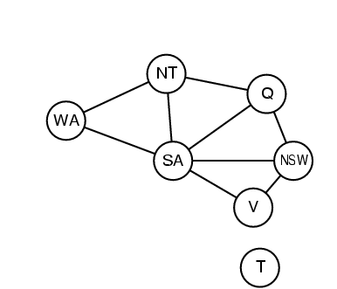
Hard matching example
Diff(wa,nt) ∧ Diff(wa,sa) ∧ Diff(nt,q) ∧ Diff(nt,sa) ∧ Diff(q,nsw) ∧ Diff(q,sa) ∧ Diff(nsw,v) ∧ Diff(nsw,sa) ∧ Diff(v,sa) ⇒ Colorable()
Diff(Red,Blue) Diff (Red,Green) Diff(Green,Red) Diff(Green,Blue) Diff(Blue,Red) Diff(Blue,Green)
Colorable() is inferred iff the CSP has a solution
CSPs include 3SAT as a special case, hence matching is NP-hard

Slide 54
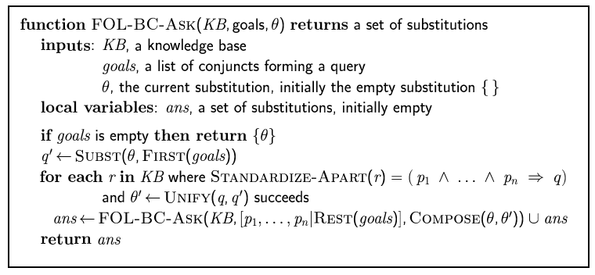
Backward chaining algorithm
SUBST(COMPOSE(θ₁, θ₂), p) = SUBST(θ₂, SUBST(θ₁, p))

Slide 55

Backward chaining example

Slide 56
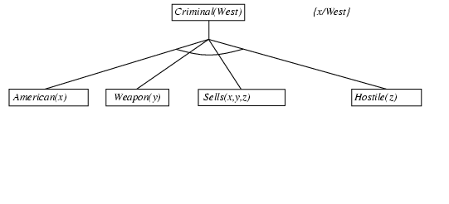
Backward chaining example

Slide 57
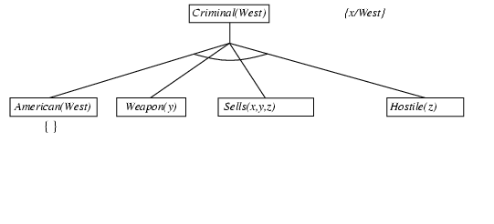
Backward chaining example

Slide 58
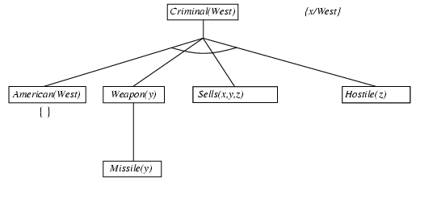
Backward chaining example

Slide 59
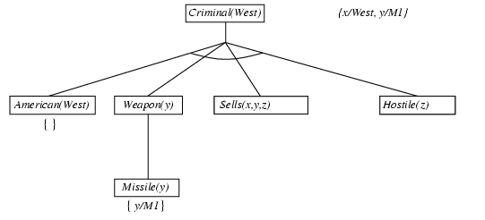
Backward chaining example

Slide 60
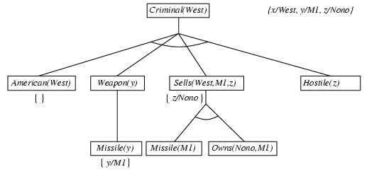
Backward chaining example

Slide 61
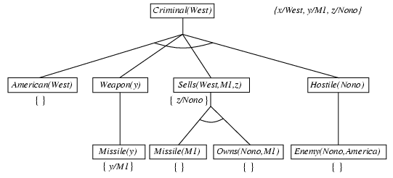
Backward chaining example

Slide 62
Backward chaining example

Slide 63
Properties of backward chaining
Depth-first recursive proof search: space is linear in size of proof
Incomplete due to infinite loops
⇒ fix by checking current goal against every goal on stack
Inefficient due to repeated subgoals (both success and failure)
⇒ fix using caching of previous results (extra space)
Widely used for logic programming

Slide 64
Methodology And Assessment Criterias
Class Assignment(s)
Each chapter being covered will have one assignment. The Case Studies will be given in line to the Changing with Speed across IT Projects in Kirirom
Internal Exam(s)
There will be 2 exams
Model Exam
There will be one Model Exam.
Semester Exam
There will be 1 Semester Exam

Slide 65
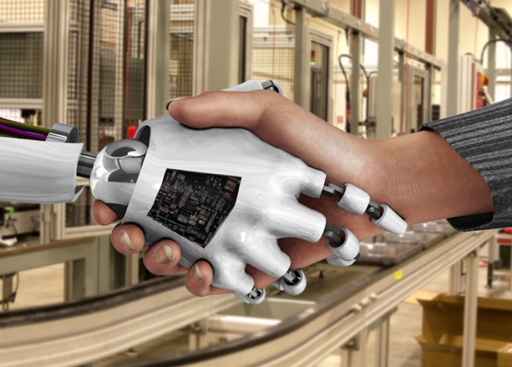
Thank You !
“An Algorithm Must Be Seen to Be Believed”
- Donald Knuth

